Slide 1
Introduction to Modeling
Software Architecture
Lecture 9

Slide 2
Objectives
Concepts
  What is modeling?
  How do we choose what to model?
  What kinds of things do we model?
  How can we characterize models?
  How can we break up and organize models?
  How can we evaluate models and modeling notations?
Examples
  Concrete examples of many notations used to model software architectures
    Revisiting Lunar Lander as expressed in different modeling notations

Slide 3
What is Architectural Modeling?
Recall that we have characterized architecture as the set of principal design decisions made about a system
We can define models and modeling in those terms
  An architectural model is an artifact that captures some or all of the design decisions that comprise a system’s architecture
  Architectural modeling is the reification and documentation of those design decisions
How we model is strongly influenced by the notations we choose:
  An architectural modeling notation is a language or means of capturing design decisions.

Slide 4
How do We Choose What to Model?
Architects and other stakeholders must make critical decisions:
  What architectural decisions and concepts should be modeled,
  At what level of detail, and
  With how much rigor or formality
These are cost/benefit decisions
  The benefits of creating and maintaining an architectural model must exceed the cost of doing so

Slide 5
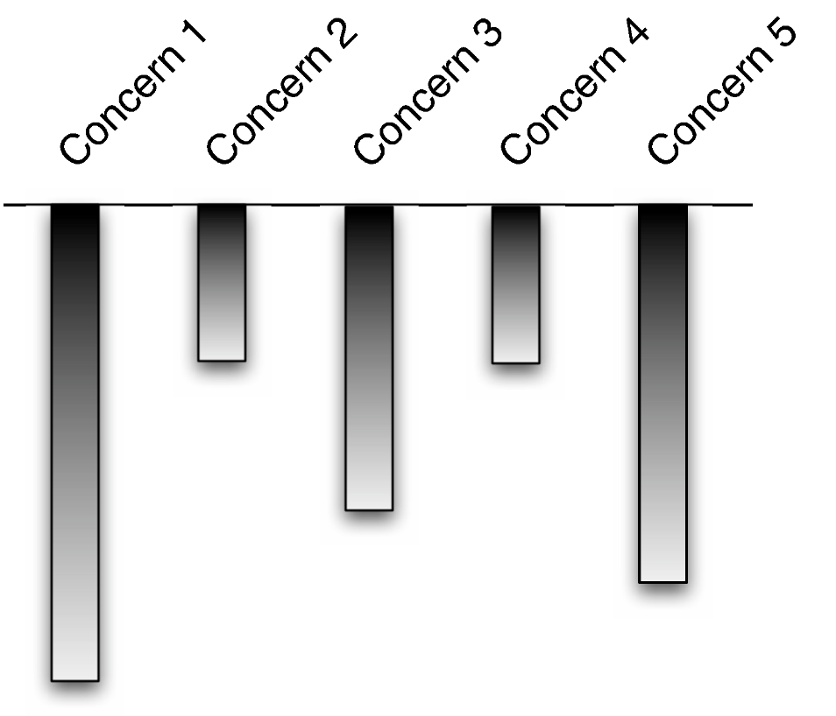
Stakeholder-Driven Modeling
Stakeholders identify aspects of the system they are concerned about
Stakeholders decide the relative importance of these concerns
Modeling depth should roughly mirror the relative importance of concerns
From Maier and Rechtin, “The Art of Systems Architecting” (2000)
Software Architecture: Foundations, Theory, and Practice; Richard N. Taylor, Nenad Medvidovic, and Eric M. Dashofy; © 2008 John Wiley & Sons, Inc. Reprinted with permission.

Slide 6

What do We Model?
Basic architectural elements
  Components
  Connectors
  Interfaces
  Configurations
  Rationale – reasoning behind decisions
Software Architecture: Foundations, Theory, and Practice; Richard N. Taylor, Nenad Medvidovic, and Eric M. Dashofy; © 2008 John Wiley & Sons, Inc. Reprinted with permission.

Slide 7
What do We Model? (cont’d)
Elements of the architectural style
  Inclusion of specific basic elements (e.g., components, connectors, interfaces)
  Component, connector, and interface types
  Constraints on interactions
  Behavioral constraints
  Concurrency constraints
  …

Slide 8
What do We Model? (cont’d)
Static and Dynamic Aspects
  Static aspects of a system do not change as a system runs
    e.g., topologies, assignment of components/connectors to hosts, …
  Dynamic aspects do change as a system runs
    e.g., State of individual components or connectors, state of a data flow through a system, …
  This line is often unclear
    Consider a system whose topology is relatively stable but changes several times during system startup

Slide 9
What do We Model? (cont’d)
Important distinction between:
  Models of dynamic aspects of a system (models do not change)
  Dynamic models (the models themselves change)

Slide 10
What do We Model? (cont’d)
Functional and non-functional aspects of a system
  Functional
    “The system prints medical records”
  Non-functional
    “The system prints medical records quickly and confidentially.”
Architectural models tend to be functional, but like rationale it is often important to capture non-functional decisions even if they cannot be automatically or deterministically interpreted or analyzed

Slide 11
Important Characteristics of Models
Ambiguity
  A model is ambiguous if it is open to more than one interpretation
Accuracy and Precision
  Different, but often conflated concepts
    A model is accurate if it is correct, conforms to fact, or deviates from correctness within acceptable limits
    A model is precise if it is sharply exact or delimited

Slide 12
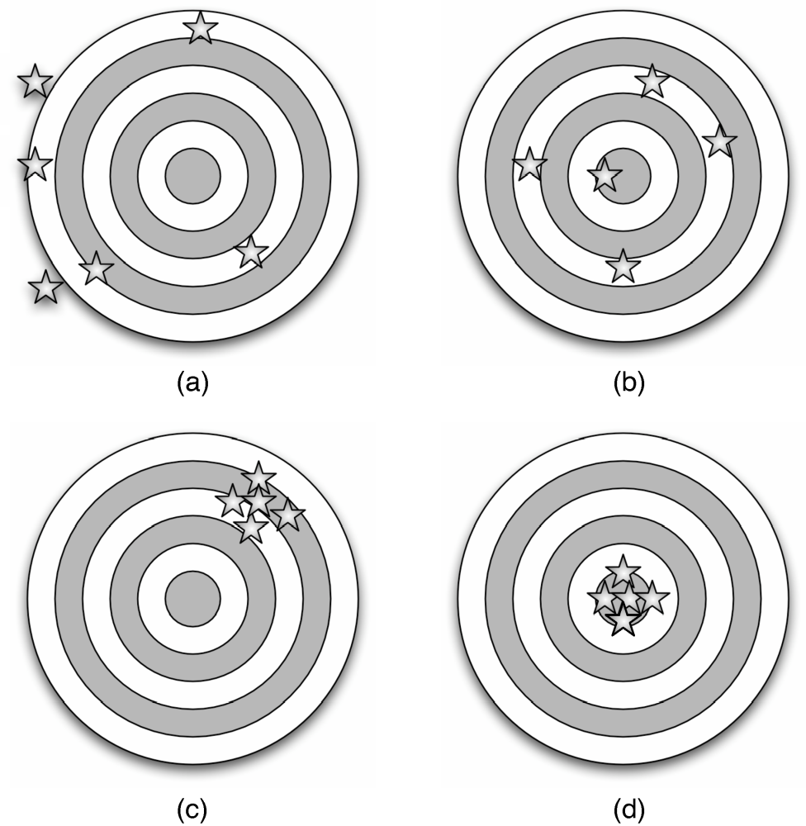
Accuracy vs. Precision
Inaccurate and imprecise: incoherent or contradictory assertions
Accurate but imprecise:
ambiguous or shallow assertions
Inaccurate but precise: detailed assertions that are wrong
Accurate and precise: detailed assertions that are correct
Software Architecture: Foundations, Theory, and Practice; Richard N. Taylor, Nenad Medvidovic, and Eric M. Dashofy; © 2008 John Wiley & Sons, Inc. Reprinted with permission.

Slide 13
Views and Viewpoints
Generally, it is not feasible to capture everything we want to model in a single model or document
  The model would be too big, complex, and confusing
So, we create several coordinated models, each capturing a subset of the design decisions
  Generally, the subset is organized around a particular concern or other selection criteria
We call the subset-model a ‘view’ and the concern (or criteria) a ‘viewpoint’

Slide 14
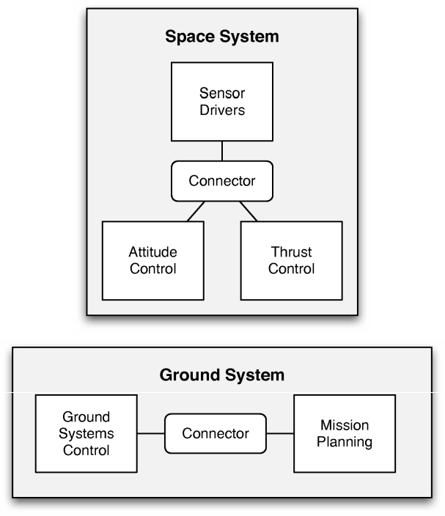
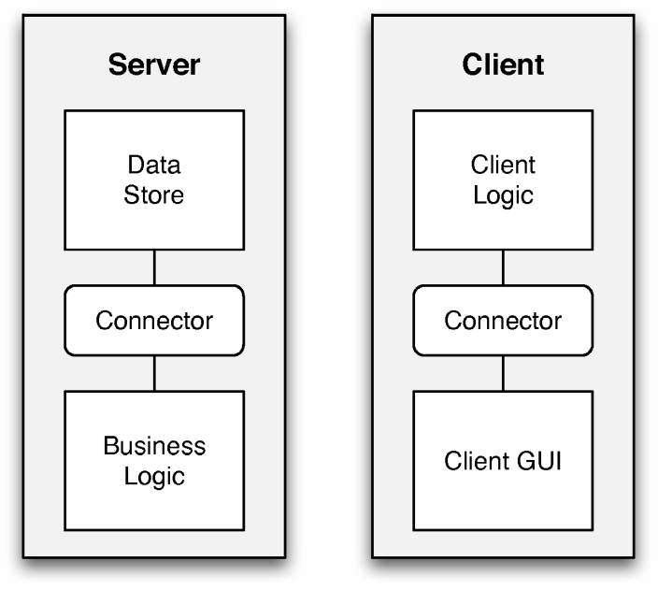
Views and Viewpoints Example
Deployment view of a 3-tier application
Deployment view of a Lunar Lander system
Both instances of the deployment viewpoint
Software Architecture: Foundations, Theory, and Practice; Richard N. Taylor, Nenad Medvidovic, and Eric M. Dashofy; © 2008 John Wiley & Sons, Inc. Reprinted with permission.

Slide 15
Commonly-Used Viewpoints
Logical Viewpoints
  Capture the logical (often software) entities in a system and how they are interconnected.
Physical Viewpoints
  Capture the physical (often hardware) entities in a system and how they are interconnected.
Deployment Viewpoints
  Capture how logical entities are mapped onto physical entities.

Slide 16
Commonly-Used Viewpoints (cont’d)
Concurrency Viewpoints
  Capture how concurrency and threading will be managed in a system.
Behavioral Viewpoints
  Capture the expected behavior of (parts of) a system.

Slide 17
Consistency Among Views
Views can contain overlapping and related design decisions
  There is the possibility that the views can thus become inconsistent with one another
Views are consistent if the design decisions they contain are compatible
  Views are inconsistent if two views assert design decisions that cannot simultaneously be true
Inconsistency is usually but not always indicative of problems
  Temporary inconsistencies are a natural part of exploratory design
  Inconsistencies cannot always be fixed

Slide 18
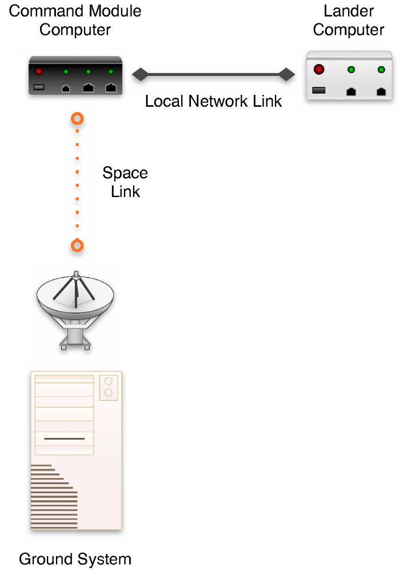
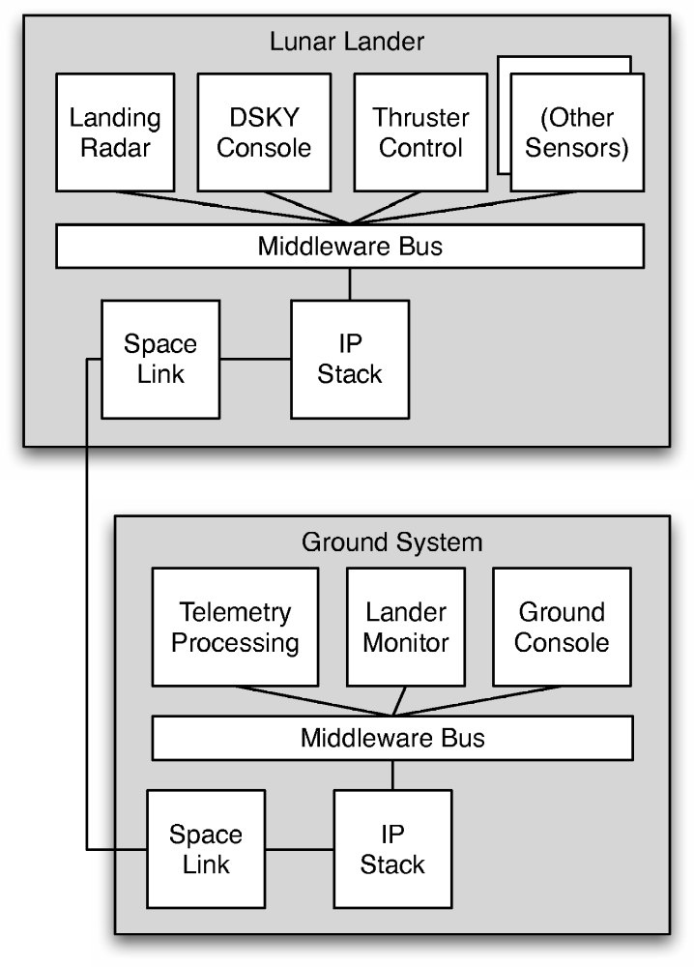
Example of View Inconsistency
Software Architecture: Foundations, Theory, and Practice; Richard N. Taylor, Nenad Medvidovic, and Eric M. Dashofy; © 2008 John Wiley & Sons, Inc. Reprinted with permission.

Slide 19
Common Types of Inconsistencies
Direct inconsistencies
  E.g., “The system runs on two hosts” and “the system runs on three hosts.”
Refinement inconsistencies
  High-level (more abstract) and low-level (more concrete) views of the same parts of a system conflict
Static vs. dynamic aspect inconsistencies
  Dynamic aspects (e.g., behavioral specifications) conflict with static aspects (e.g., topologies)

Slide 20
Common Types of Inconsistencies (cont’d)
Dynamic vs. dynamic aspect inconsistencies
  Different descriptions of dynamic aspects of a system conflict
Functional vs. non-functional inconsistencies

Slide 21
Evaluating Modeling Approaches
Scope and purpose
  What does the technique help you model? What does it not help you model?
Basic elements
  What are the basic elements (the ‘atoms’) that are modeled? How are they modeled?
Style
  To what extent does the approach help you model elements of the underlying architectural style? Is the technique bound to one particular style or family of styles?

Slide 22
Evaluating Modeling Approaches (cont’d)
Static and dynamic aspects
  What static and dynamic aspects of an architecture does the approach help you model?
Dynamic modeling
  To what extent does the approach support models that change as the system executes?
Non-functional aspects
  To what extent does the approach support (explicit) modeling of non-functional aspects of architecture?

Slide 23
Evaluating Modeling Approaches (cont’d)
Ambiguity
  How does the approach help you to avoid (or embrace) ambiguity?
Accuracy
  How does the approach help you to assess the correctness of models?
Precision
  At what level of detail can various aspects of the architecture be modeled?

Slide 24
Evaluating Modeling Approaches (cont’d)
Viewpoints
  Which viewpoints are supported by the approach?
Viewpoint Consistency
  How does the approach help you assess or maintain consistency among different viewpoints?

Slide 25
Surveying Modeling Approaches
Generic approaches
  Natural language
  PowerPoint-style modeling
  UML, the Unified Modeling Language
Early architecture description languages
  Darwin
  Rapide
  Wright
Domain- and style-specific languages
  Koala
  Weaves
  AADL
Extensible architecture description languages
  Acme
  ADML
  xADL

Slide 26
Surveying Modeling Approaches (cont’d)
Generic approaches
  Natural language
  PowerPoint-style modeling
  UML, the Unified Modeling Language
Early architecture description languages
  Darwin
  Rapide
  Wright
Domain- and style-specific languages
  Koala
  Weaves
  AADL
Extensible architecture description languages
  Acme
  ADML
  xADL

Slide 27
Natural Language
Spoken/written languages such as English
Advantages
  Highly expressive
  Accessible to all stakeholders
  Good for capturing non-rigorous or informal architectural elements like rationale and non-functional requirements
  Plentiful tools available (word processors and other text editors)
Disadvantages
  Ambiguous, non-rigorous, non-formal
  Often verbose
  Cannot be effectively processed or analyzed by machines/software

Slide 28
Natural Language Example
“The Lunar Lander application consists of three components: a data store component, a calculation component, and a user interface component.
The job of the data store component is to store and allow other components access to the height, velocity, and fuel of the lander, as well as the current simulator time.
The job of the calculation component is to, upon receipt of a burn-rate quantity, retrieve current values of height, velocity, and fuel from the data store component, update them with respect to the input burn-rate, and store the new values back. It also retrieves, increments, and stores back the simulator time. It is also responsible for notifying the calling component of whether the simulator has terminated, and with what state (landed safely, crashed, and so on).
The job of the user interface component is to display the current status of the lander using information from both the calculation and the data store components. While the simulator is running, it retrieves the new burn-rate value from the user, and invokes the calculation component.”

Slide 29
Related Alternatives
Ambiguity can be reduced and rigor can be increased through the use of techniques like ‘statement templates,’ e.g.:
  The (name) interface on (name) component takes (list-of-elements) as input and produces (list-of-elements) as output (synchronously | asynchronously).
  This can help to make rigorous data easier to read and interpret, but such information is generally better represented in a more compact format

Slide 30
Natural Language Evaluation
Scope and purpose
  Capture design decisions in prose form
Basic elements
  Any concepts required
Style
  Can be described by using more general language
Static & Dynamic Aspects
  Any aspect can be modeled
Dynamic Models
  No direct tie to implemented/ running system
Non-Functional Aspects
  Expressive vocabulary available (but no way to verify)
Ambiguity
  Plain natural language tends to be ambiguous; statement templates and dictionaries help
Accuracy
  Manual reviews and inspection
Precision
  Can add text to describe any level of detail
Viewpoints
  Any viewpoint (but no specific support for any particular viewpoint)
Viewpoint consistency
  Manual reviews and inspection

Slide 31
Informal Graphical Modeling
General diagrams produced in tools like PowerPoint and OmniGraffle
Advantages
  Can be aesthetically pleasing
  Size limitations (e.g., one slide, one page) generally constrain complexity of diagrams
  Extremely flexible due to large symbolic vocabulary
Disadvantages
  Ambiguous, non-rigorous, non-formal
    But often treated otherwise
  Cannot be effectively processed or analyzed by machines/software

Slide 32
Informal Graphical Model Example
Software Architecture: Foundations, Theory, and Practice; Richard N. Taylor, Nenad Medvidovic, and Eric M. Dashofy; © 2008 John Wiley & Sons, Inc. Reprinted with permission.

Slide 33
Related Alternatives
Some diagram editors (e.g., Microsoft Visio) can be extended with semantics through scripts and other additional programming
  Generally ends up somewhere in between a custom notation-specific editor and a generic diagram editor
  Limited by extensibility of the tool
PowerPoint Design Editor (Goldman, Balzer) was an interesting project that attempted to integrate semantics into PowerPoint

Slide 34
Informal Graphical Evaluation
Scope and purpose
  Arbitrary diagrams consisting of symbols and text
Basic elements
  Geometric shapes, splines, clip-art, text segments
Style
  In general, no support
Static & Dynamic Aspects
  Any aspect can be modeled, but no semantics behind models
Dynamic Models
  Rare, although APIs to manipulate graphics exist
Non-Functional Aspects
  With natural language annotations
Ambiguity
  Can be reduced through use of rigorous symbolic vocabulary/dictionaries
Accuracy
  Manual reviews and inspection
Precision
  Up to modeler; generally canvas is limited in size (e.g., one ‘slide’)
Viewpoints
  Any viewpoint (but no specific support for any particular viewpoint)
Viewpoint consistency
  Manual reviews and inspection

Slide 35
UML – the Unified Modeling Language
13 loosely-interconnected notations called diagrams that capture static and dynamic aspects of software-intensive systems
Advantages
  Support for a diverse array of viewpoints focused on many common software engineering concerns
  Ubiquity improves comprehensibility
  Extensive documentation and tool support from many vendors
Disadvantages
  Needs customization through profiles to reduce ambiguity
  Difficult to assess consistency among views
  Difficult to capture foreign concepts or views

Slide 36
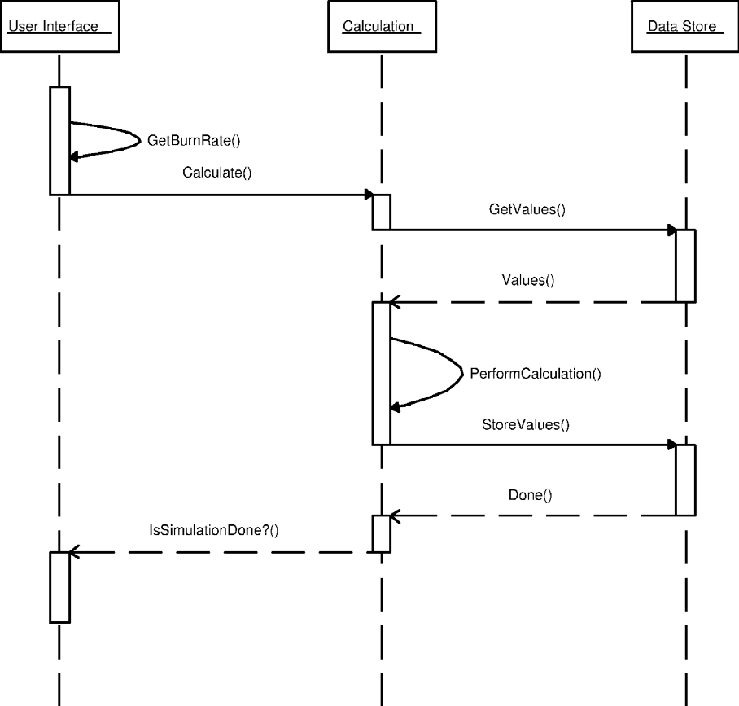
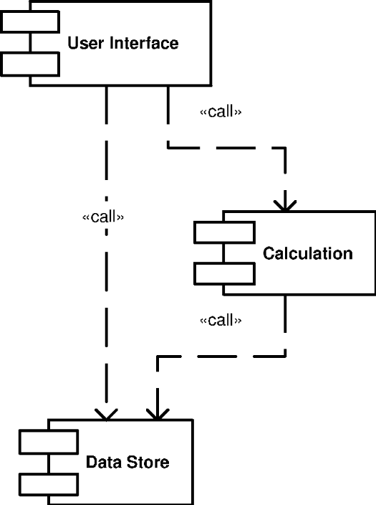
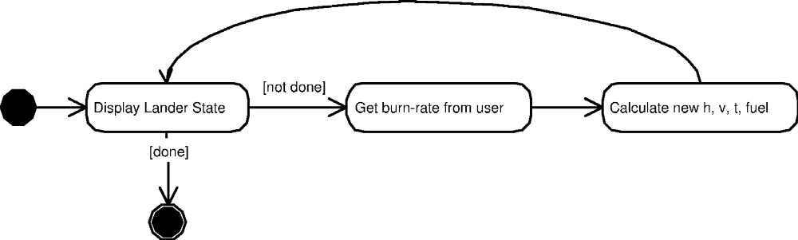
UML Example
Software Architecture: Foundations, Theory, and Practice; Richard N. Taylor, Nenad Medvidovic, and Eric M. Dashofy; © 2008 John Wiley & Sons, Inc. Reprinted with permission.

Slide 37
UML Evaluation
Ambiguity
  Many symbols are interpreted differently depending on context; profiles reduce ambiguity
Accuracy
  Well-formedness checks, automatic constraint checking, ersatz tool methods, manual
Precision
  Up to modeler; wide flexibility
Viewpoints
  Each diagram type represents a viewpoint; more can be added through overloading/profiles
Viewpoint consistency
  Constraint checking, ersatz tool methods, manual
Scope and purpose
  Diverse array of design decisions in 13 viewpoints
Basic elements
  Multitude – states, classes, objects, composite nodes…
Style
  Through (OCL) constraints
Static & Dynamic Aspects
  Some static diagrams (class, package), some dynamic (state, activity)
Dynamic Models
  Rare; depends on the environment
Non-Functional Aspects
  No direct support; natural-language annotations

